Slide 1

Networking and why you need OCD
By Josh (future Chairman with great social skills)

Slide 2
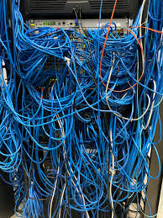
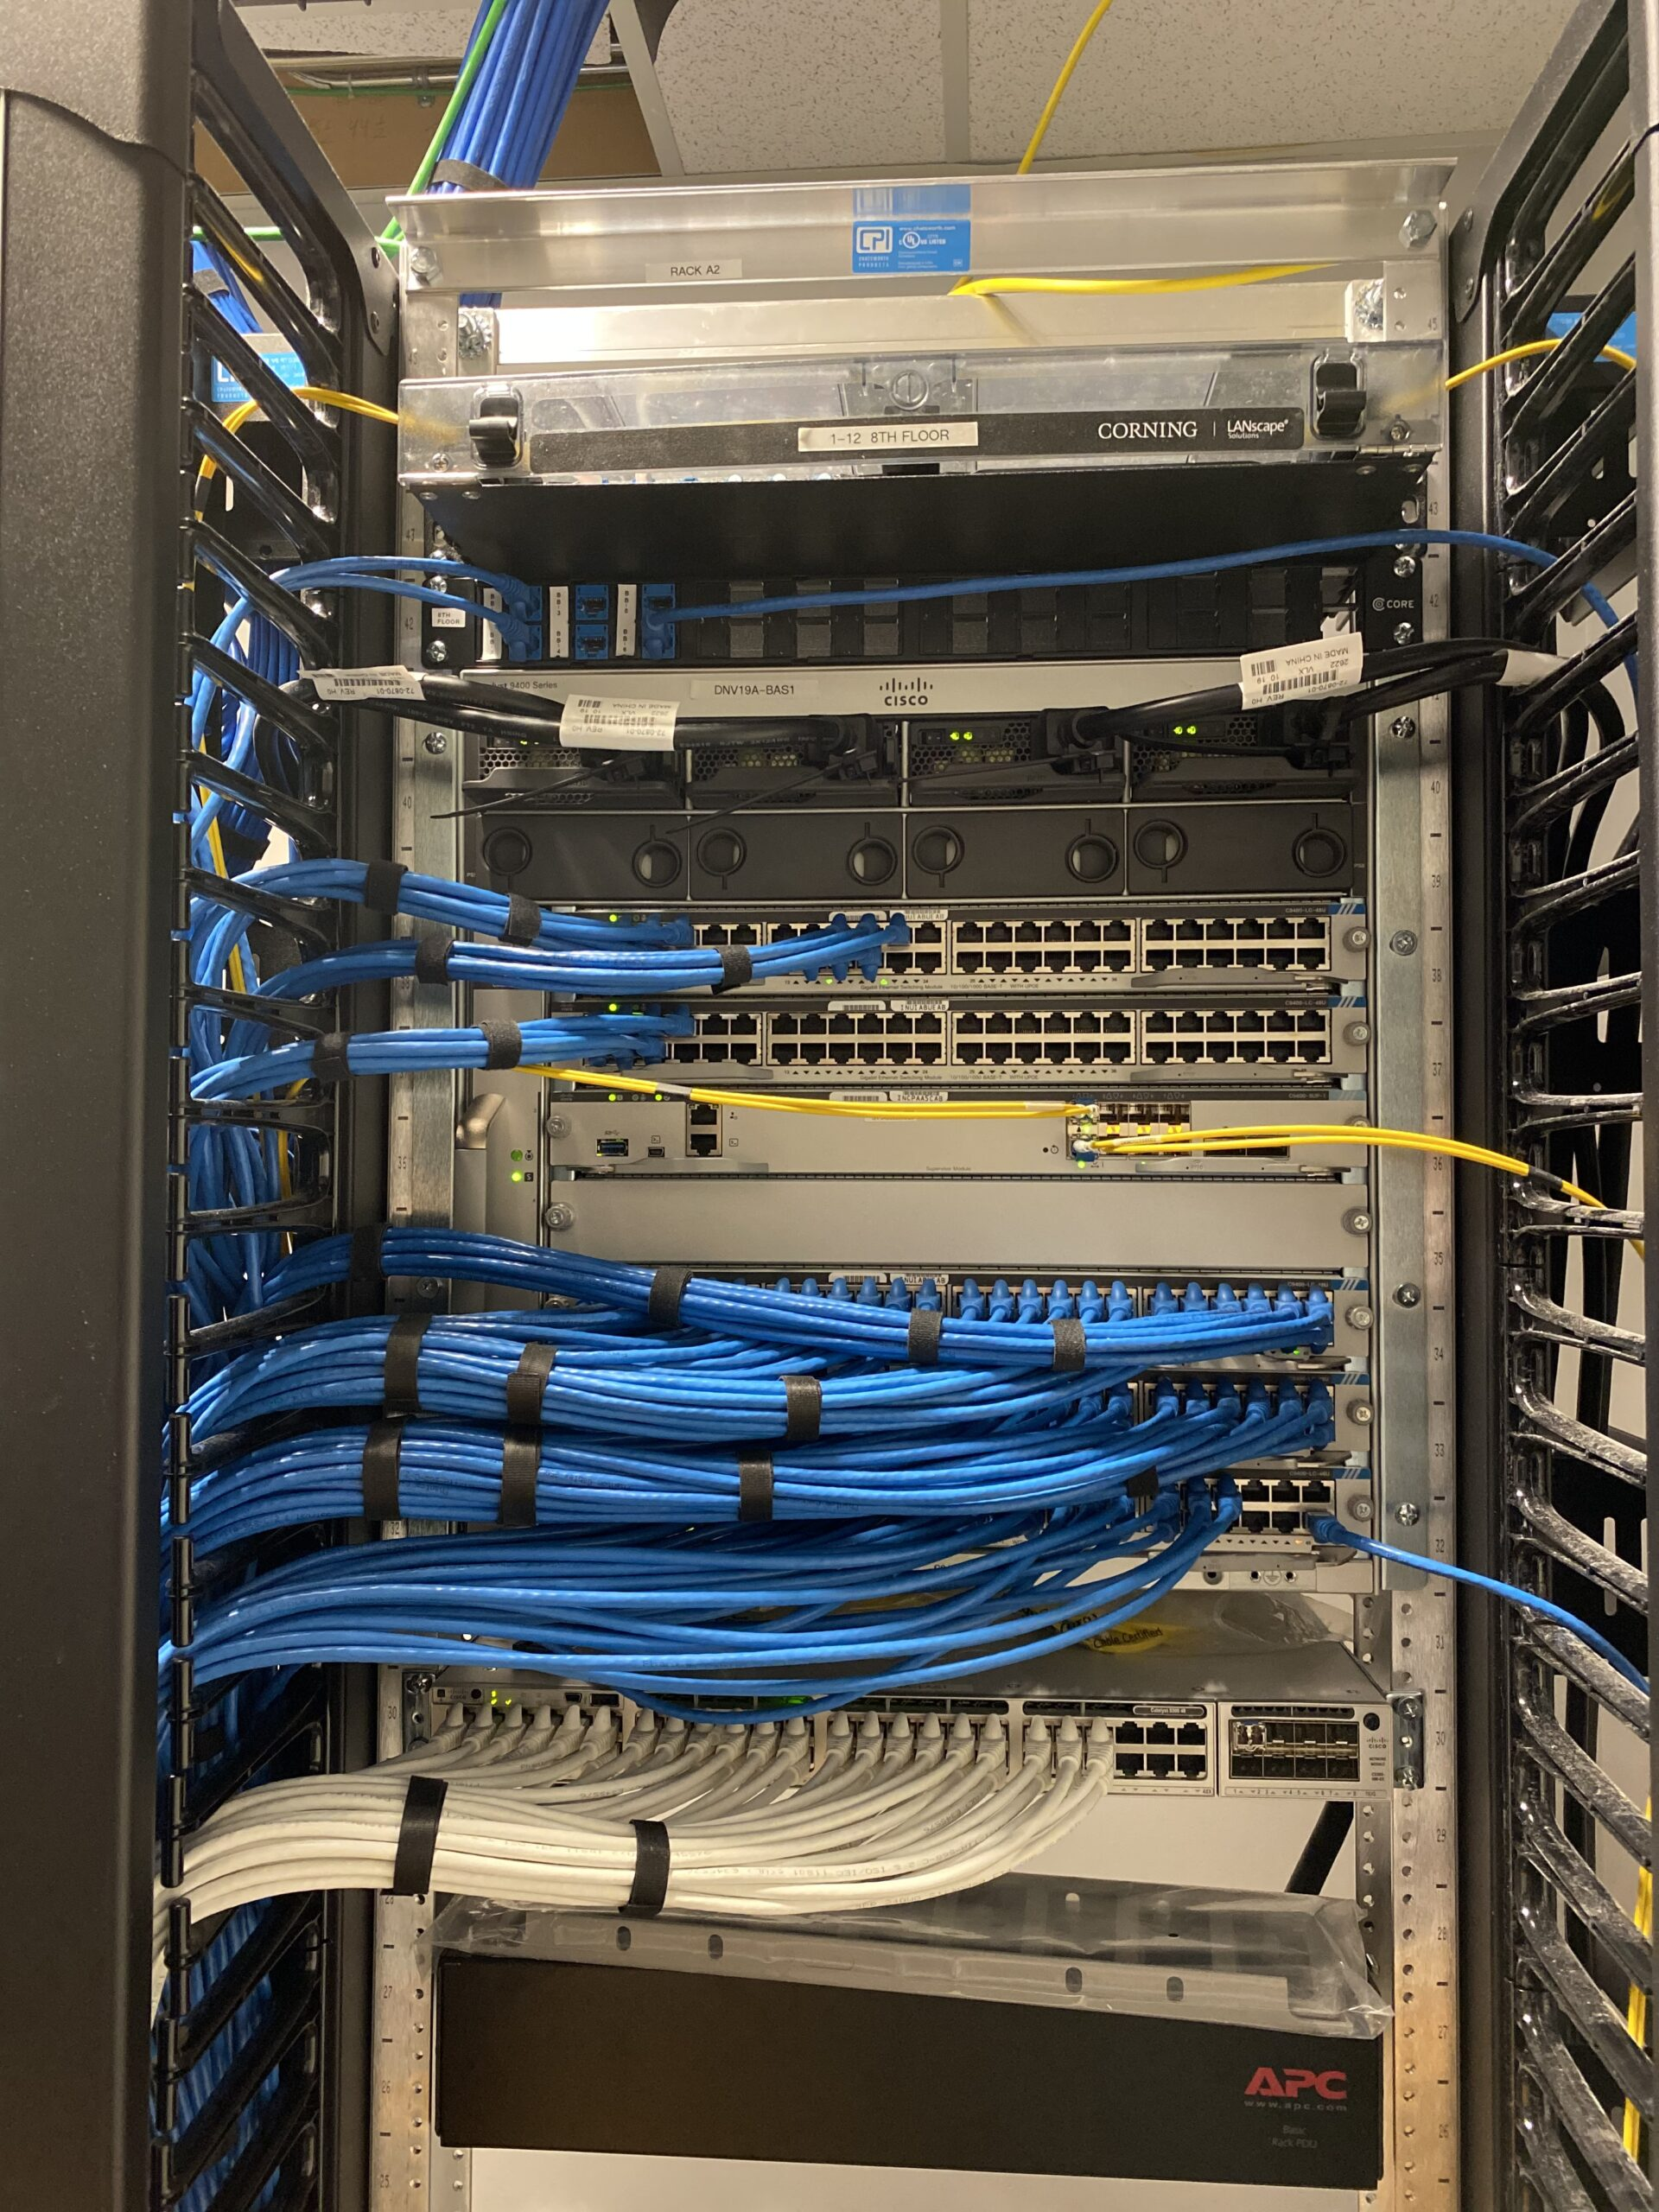
What do I mean by networking
The guy she tells you not to worry about:
You:
Basically how everything works
Each network uses a combination of switches and routers and probably WAPs
Like everything, they like to break very often for no reason
CABLE MANAGEMENT IS A MUST
IPv4 is standard, we pretend IPv6 doesn’t exist, its hard to configure and stinky to use

Slide 3

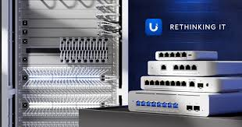
The cool parts of networking:
Sectioning off parts to give you more security (VLANs, Subnets)
Feeling like you’ve done adult lego when it’s complete
Having control and visualisation over every single part of your network
Having to fight the erg to buy shiny new equipment when you don’t need it
Attracts your preferred gender at your epic computer skills
Host own servers

Slide 4
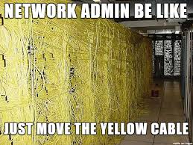

Downsides:
MONEY (please give me some so I can buy more networking gear)
It takes a lot of space, so girlfriends normally say no ☹
They take time to maintain and keep running effectively and smoothly
Messy cable management makes fixing problems hard
Power bill goes

Slide 5


HOWEVER!

Slide 6

There are solutions:
Steal the equipment (Legally I have to say this is a joke)
Ignore your partner, networking is more important
The power bill is worth it, just ignore the government, I doubt they’ll kick your door down
Don’t be mess and actually cable manage so you can fix problems
(I couldn’t be bothered
To fix the background)

Slide 7
Tips for configuring your home network:
Have multiple SSIDs and WAPs, increases speed and you can give your family slower connections, so they don’t kill the internet with facebook reels or whatever old people do on wifi
Host game and plex/media servers, they save money on subscriptions, and are fun to mess around with (plus can run on anything with enough ram)
Use subnets and VLANs, these are good to section your servers, which stop people who look like this accessing your home network →
Setup a home VPN, as then you can connect to your house from anywhere

Slide 8
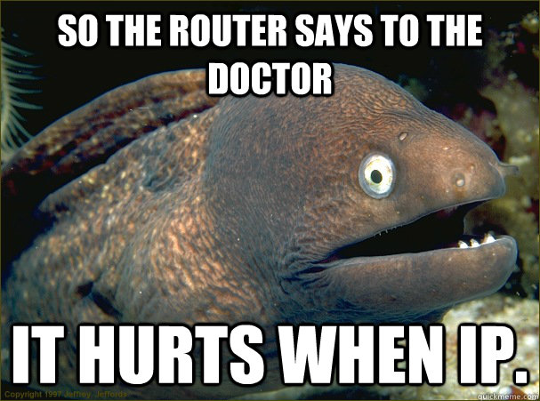

Something cool to look into:
if you’re interested, look into software called pfSense, its an open source firewall and routing software and is very cool.
Gives you complete config, more than most basic routers that come with your ISP, and as you play with it you’ll pick up more about how networks work.
Also helps you decide if you wanna spend the money on expense stuff like a ubiquiti router (I have one, they’re class)
It’s a good free starting point, and is very fun to break if nothing more.

Slide 9

In Conclusion:
thanks for listening to my rambles, *if you couldn’t tell I very much like playing with networks
I have far too much free time and like to play with different coloured cables that give internet, and would recommend you have a play too.
If you look at ebay and Facebook marketplace you can find a lot of “old” (probably 4 years old) hardware to explore and play with and break, but satisfying to make work after many hours
Plus having OCD gives you a cable management buff ☺

